Slide 1
Image Enhancement
Arpit Pati
Satyam Sovan Mishra
Subrat Kumar Patra
Kashif Nehal
Naman Agarwal

Slide 2
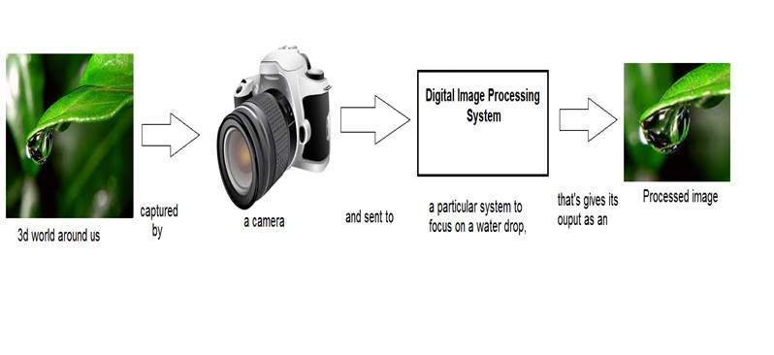
Introduction on Image Processing !
Very often we use cameras but have you ever wondered how to cameras produce images ! Well then digital image processing or simply image processing ,deals with manipulation of digital images through a digital computer. It is a subfield of signals and systems but focus particularly on images.Our project is on Image Enhancement which deals with Image Processing.

Slide 3
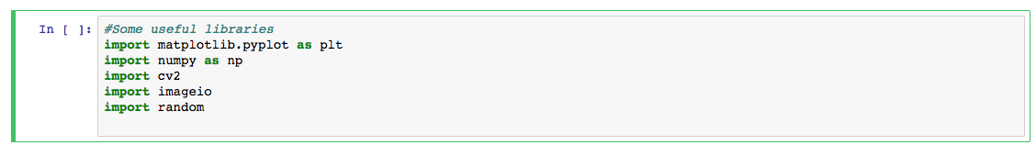
Some useful libraries for Image Processing using Python
Matplotlib PIL
Numpy Opencv
*All programs are done using Anaconda and Jupyter Notebook

Slide 4
What we would be covering in this project ?
1.Loading an image
2.Displaying image
3.Showing image’s matrix form (RGB)
4.Increasing sharpness
5.Exposure Correction (Brightness , Contrast)
6.Denoising
(...more to go on next presentation)

Slide 5
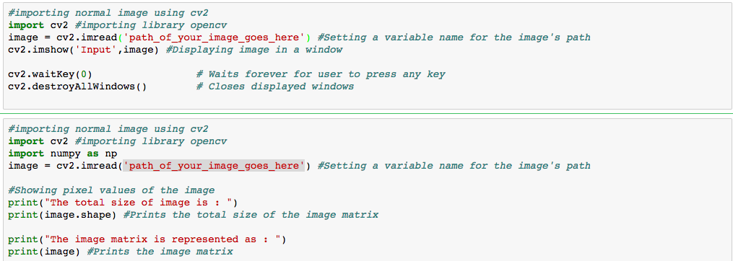
Loading and Displaying

Slide 6
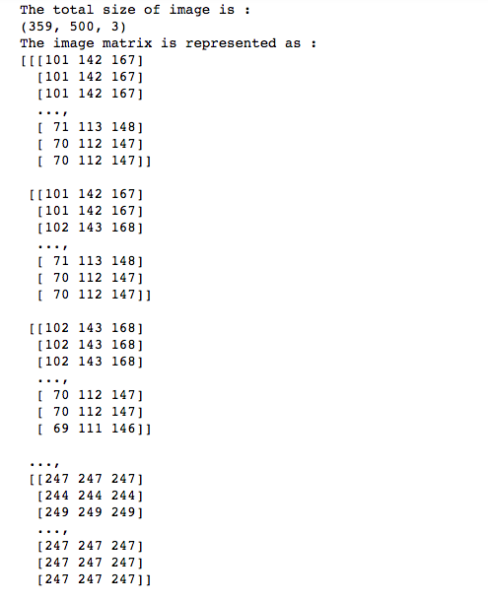
=> import keyword is used to import the package in python
=> cv2.imread(‘parameter1’).This function loads an image.Here parameter1 is the path of the image we want to load
=> cv2.imshow(parameter1,parameter2).This function displays the image.Here parameter1 is the name of window and parameter2 is name of the variable for image that we loaded
=>image is the matrix form of the image.Image consist of RGB components so that’s how we can see it’s composition
=> image.shape is the total size of the RGB matrix of image
=>cv2.imwrite(‘parameter1’,parameter2).This function writes an image to the file in simple words it saves the image.Here parameter1 is the path where we want to save image and the latter is the variable name of the image that we want to save

Slide 7
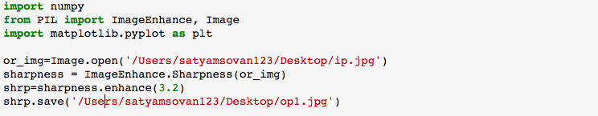
Increasing sharpness of an image
Here we are using another new library called PIL (pillow).
We imported class PIL.ImageEnhance._Enhance
All enhancement classes implement a common interface, containing a single method.It has various other sub-classes like class PIL.ImageEnhance.Color , class PIL.ImageEnhance.Contrast , class PIL.ImageEnhance.Sharpness , class PIL.ImageEnhance.Brightness

Slide 8
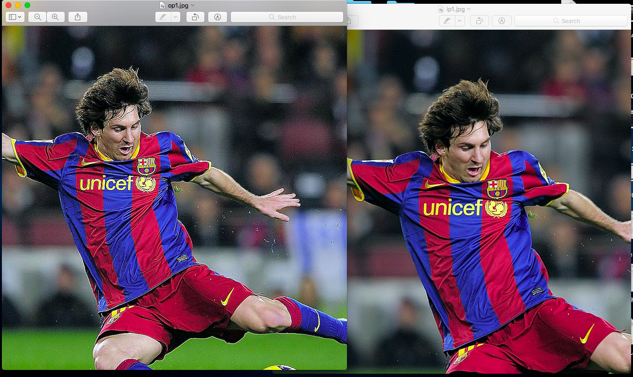
Output of the code in previous slide

Slide 9
Denoising-Removing unwanted components
For denoising we are again taking the help of a function from opencv. It is called fastNlMeansDenoisingColored(InputArray src, OutputArray dst, float h=3, float hColor=3, int templateWindowSize=7, int searchWindowSize=21 ).It takes 6 parameters.
src – Input 8-bit 3-channel image.
dst – Output image with the same size and type as src .
h – Parameter regulating filter strength for luminance component. Bigger h value perfectly removes noise but also removes image details, smaller h value preserves details but also preserves some noise
hColor – For most images value equals 10 will be enough to remove colored noise and do not distort colors
templateWindowSize – Size in pixels of the template patch that is used to compute weights. Should be odd. Recommended value 7 pixels
searchWindowSize – Size in pixels of the window that is used to compute weighted average for given pixel. Should be odd. Affect performance linearly: greater searchWindowsSize - greater denoising time. Recommended value 21 pixels

Slide 10
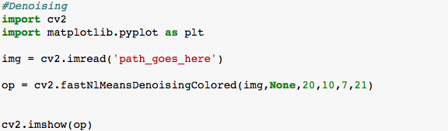
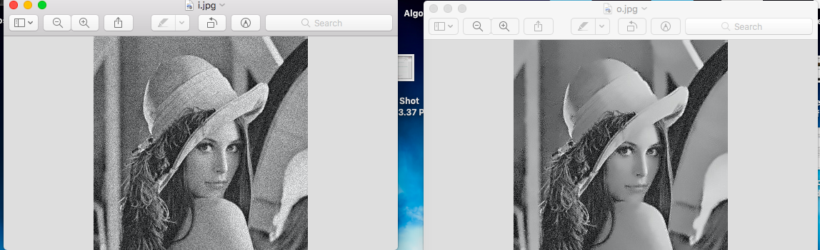

Slide 11
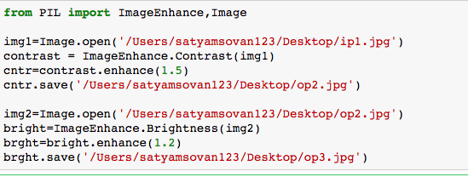
Exposure Correction
We also have to lookup for the exposure of the image too for enhancement thus we also need to focus on brightness , contrast . So here we have used fucntions from PIL library which takes only image as parameter.

Slide 12
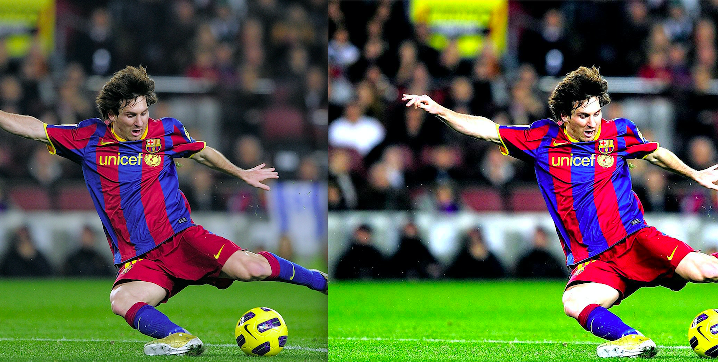

Slide 13
That’s all for today’s presentation and hope you liked it !

